Slide 1

Obstacle Avoiding Robot Using Arduino course name: CMBE455 Embedded Systems Instructor: Asst. Prof. Dr. Parvaneh ESMAILI Team Members: Roba hassan-22213944 Lina Ahmed-22210907 Omar Alawi-22208538 Fares Almashharawi-22215416 Qusai Almashharawi-22205407

Slide 2
.
Introduction :
This robot obstacle avoidance project demonstrates a simple and effective obstacle avoidance system using sensor and a microcontroller.
Definition :
It is a robot that detects obstacles in the environment through the use of ultrasonic sensors (reactive sensor-based detection) and responds to obstacles by avoiding them.
Objective :
The main aim of it is to protect both the robot itself and the surrounding objects.

Slide 3
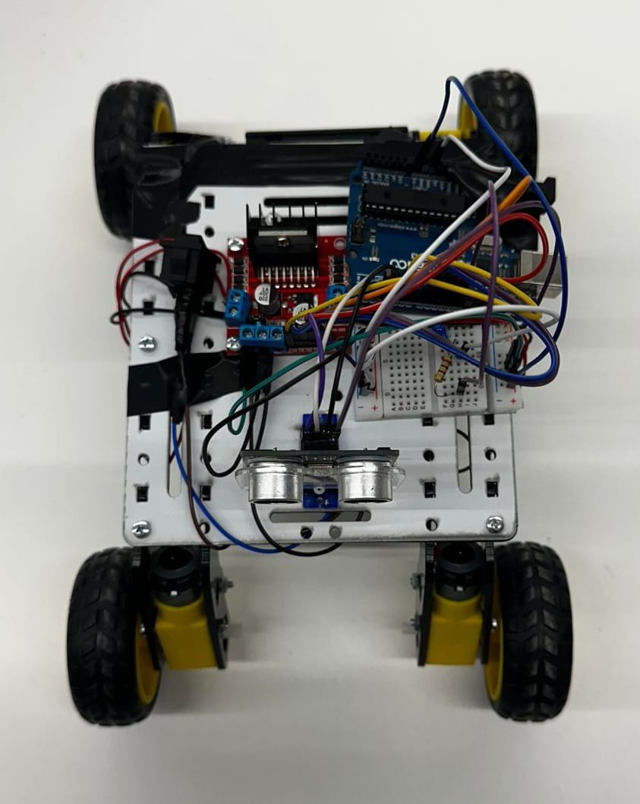
System Overview :
The ultrasonic sensor continuously scans the front area for obstacles.
Distance data is sent to the Arduino microcontroller.
Arduino analyzes the distance and makes a movement decision.
Control signals are sent to the motor driver.
Motors rotate accordingly to change direction and avoid obstacles.

Slide 4
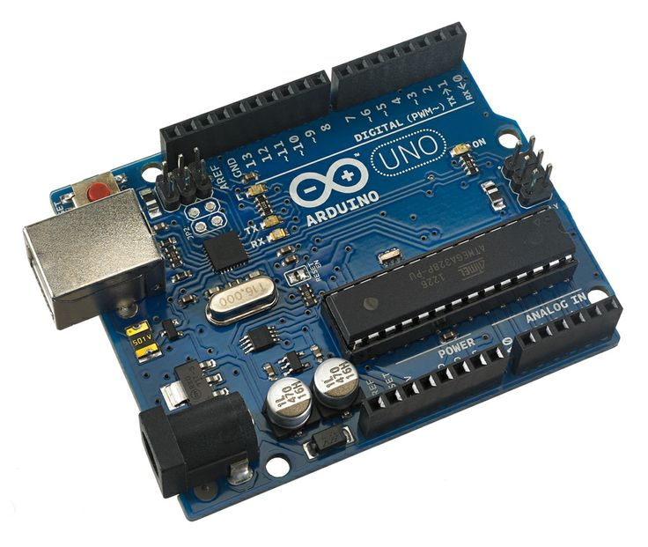
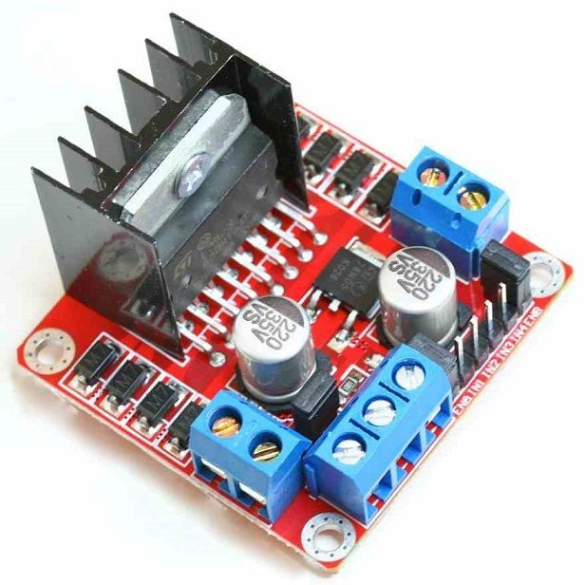
Hardware Components :
Arduino UNO :
Main controller of the robot
Processes sensor data
Programmed using C++
Sends control signals to motor driver.
Motor Driver (L298N) :
Dual H-Bridge motor driver
Controls direction of DC motors
Controls motor speed using PWM
Receives commands from Arduino.

Slide 5
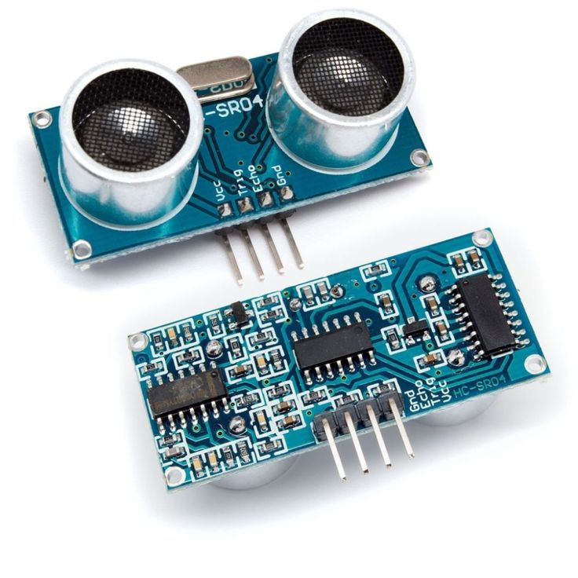
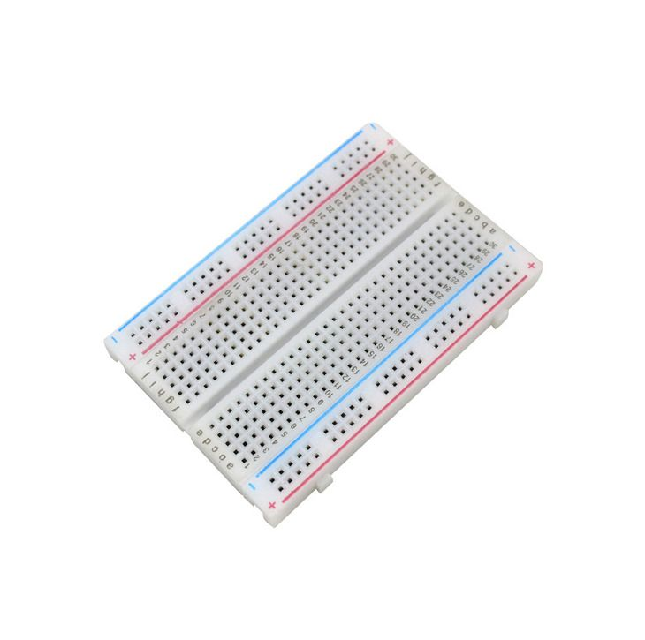
Ultrasonic Sensor (HC-SR04) :
Measures distance to obstacles
Uses ultrasonic sound waves
Sends echo signal to Arduino
Enables obstacle detection.
Breadboard :
Used for temporary circuit connections
Simplifies wiring and testing
No soldering required
Helps organize components.

Slide 6
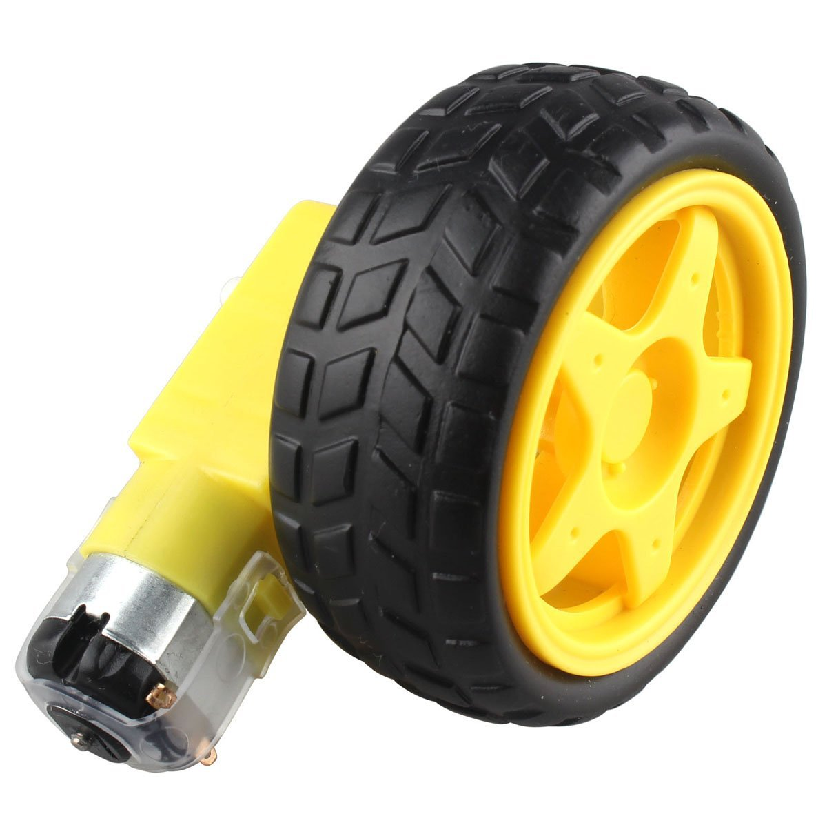
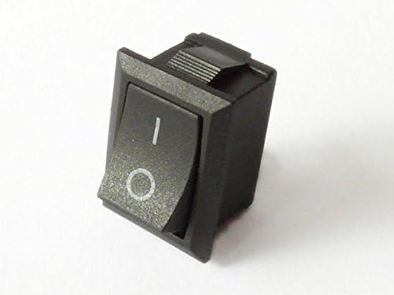
4 DC Motors & Wheels :
Provide movement to the robot
Convert electrical energy to motion
Controlled by motor driver
Enable forward, backward, and turning motion.
Switch :
Turns the robot ON and OFF
Controls power supply to the system
Improves safety and usability
Prevents unnecessary battery drain.

Slide 7
#define trigPin 4
#define echoPin 3
// L298N
#define ENA 5
#define ENB 6
#define IN1 8
#define IN2 9
#define IN3 10
#define IN4 11
long duration;
int d1, d2, distance;
int readDistance() {
digitalWrite(trigPin, LOW);
delayMicroseconds(2);
digitalWrite(trigPin, HIGH);
delayMicroseconds(10);
digitalWrite(trigPin, LOW);
duration = pulseIn(echoPin, HIGH, 30000);
if (duration == 0) return 100;
return duration * 0.034 / 2;
}
void forward() {
digitalWrite(ENA, HIGH);
digitalWrite(ENB, HIGH);
digitalWrite(IN1, HIGH);
digitalWrite(IN2, LOW);
digitalWrite(IN3, HIGH);
digitalWrite(IN4, LOW);
}
void backward() {
digitalWrite(ENA, HIGH);
digitalWrite(ENB, HIGH);
digitalWrite(IN1, LOW);
digitalWrite(IN2, HIGH);
digitalWrite(IN3, LOW);
digitalWrite(IN4, HIGH);
}
void rightTurn() {
digitalWrite(ENA, HIGH);
digitalWrite(ENB, HIGH);
digitalWrite(IN1, HIGH);
digitalWrite(IN2, LOW);
digitalWrite(IN3, LOW);
digitalWrite(IN4, HIGH);
}

Slide 8
void stopCar() {
digitalWrite(IN1, LOW);
digitalWrite(IN2, LOW);
digitalWrite(IN3, LOW);
digitalWrite(IN4, LOW);
}
void setup() {
pinMode(trigPin, OUTPUT);
pinMode(echoPin, INPUT);
pinMode(ENA, OUTPUT);
pinMode(ENB, OUTPUT);
pinMode(IN1, OUTPUT);
pinMode(IN2, OUTPUT);
pinMode(IN3, OUTPUT);
pinMode(IN4, OUTPUT);
Serial.begin(9600);
} void loop() {
d1 = readDistance();
delay(50);
d2 = readDistance();
distance = min(d1, d2);
Serial.print("Distance: ");
Serial.println(distance);
if (distance > 25) {
forward();
}
else {
stopCar();
delay(200);
backward();
delay(700);
rightTurn();
delay(830);
}
}

Slide 9
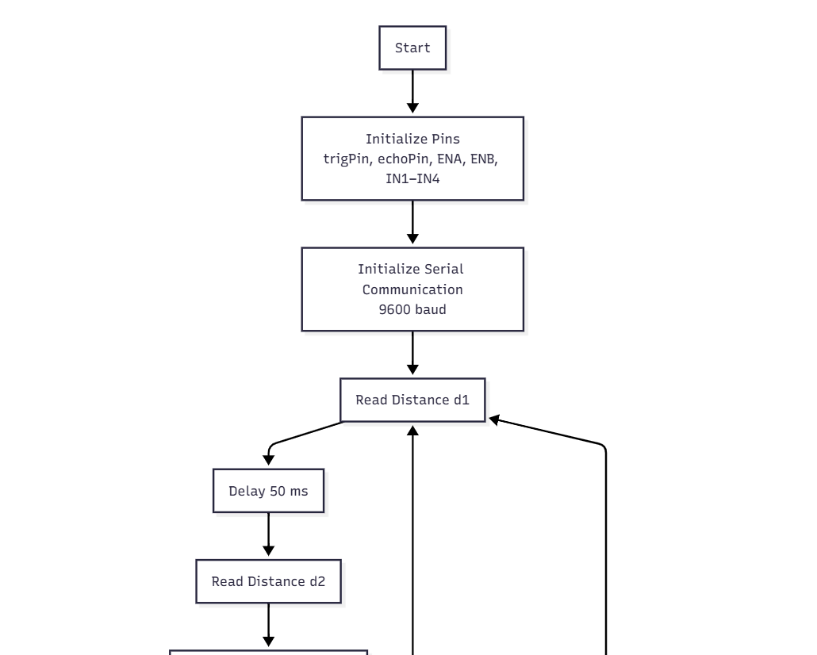
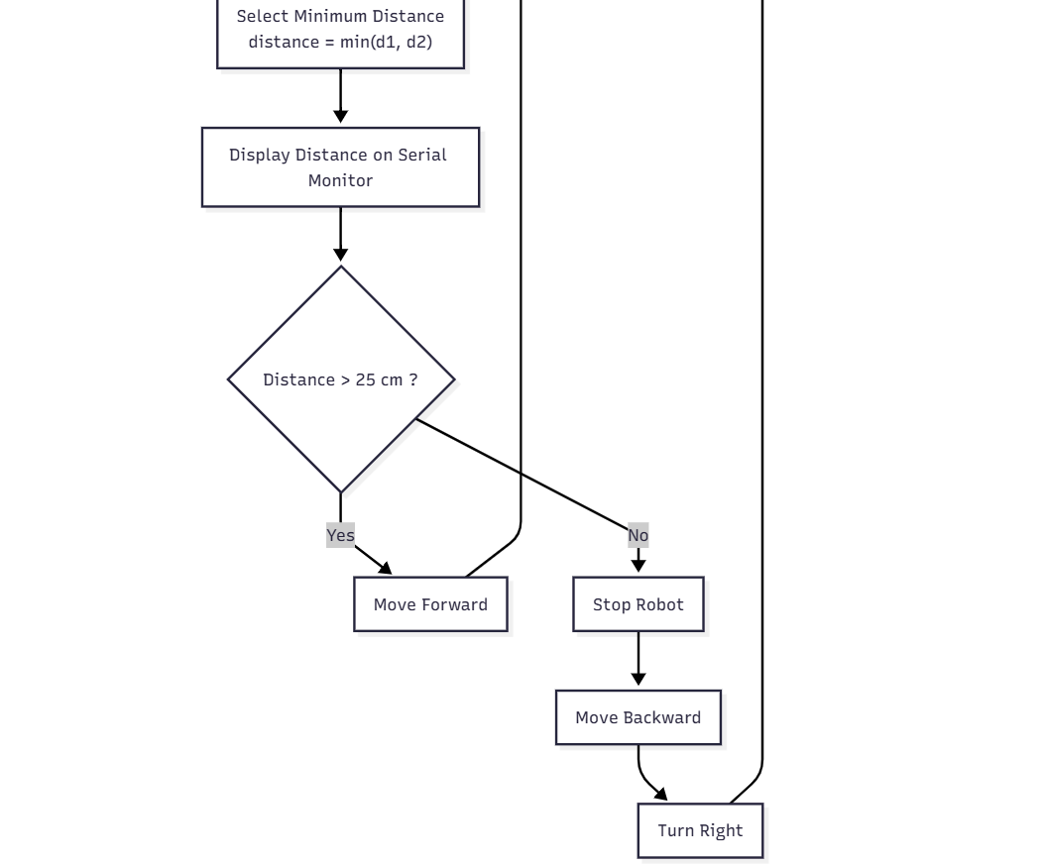

Slide 10
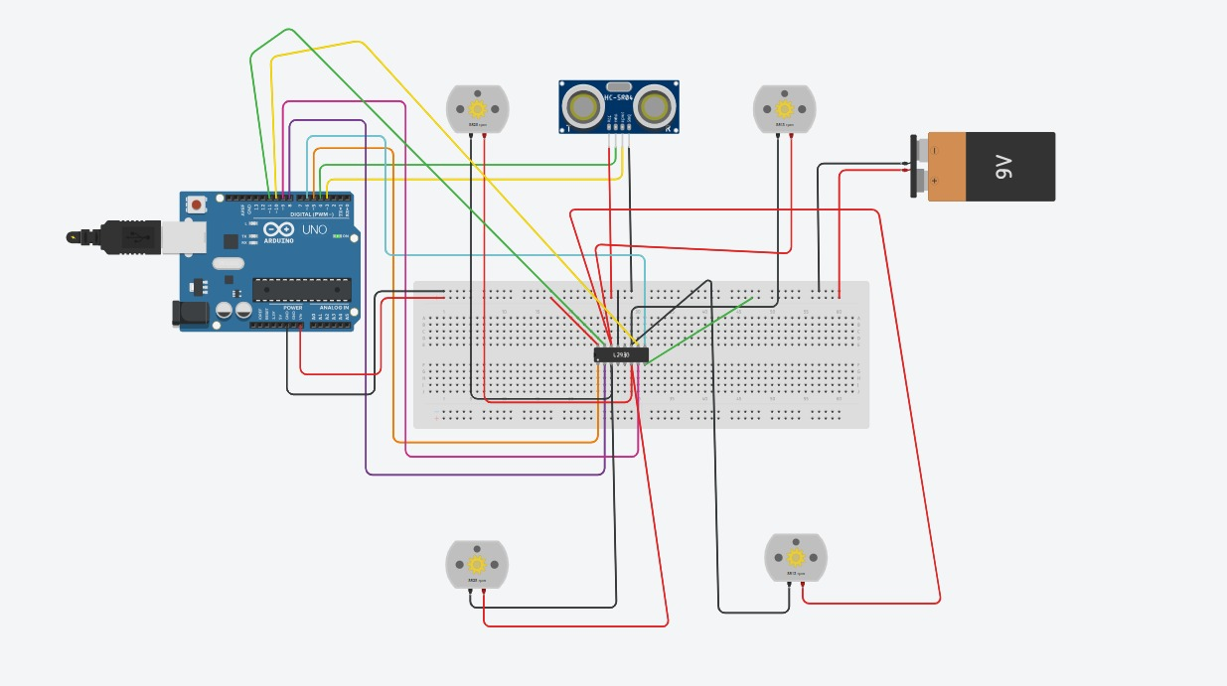

Slide 11
Challenges & Solutions :
First Problem:
The robot sometimes moved too close to obstacles before reacting.
Solution:
A safe distance threshold of 25 cm was defined.
The robot stops immediately before changing direction.
Second Problem:
Motors did not move in the correct direction initially.
Solution:
Motor driver pin connections ware checked.
Correct HIGH/LOW logic was applied to IN1-IN4 pins.

Slide 12
Project Results:
Conclusion:
The obstacle-avoiding robot successfully detects nearby objects using the ultrasonic sensor.
The robot moves forward autonomously when no obstacle is detected. When an object is detected within a distance of 25 cm, the robot responds effectively by stopping immediately, moving backward, and then turning right to avoid collision.
The system operates in real time without human intervention and demonstrates smooth, reliable, and safe obstacle avoidance behavior. Overall, the project confirms that simple sensors and control logic can be effectively used to build an autonomous robot capable of navigating its environment safely.

Slide 13
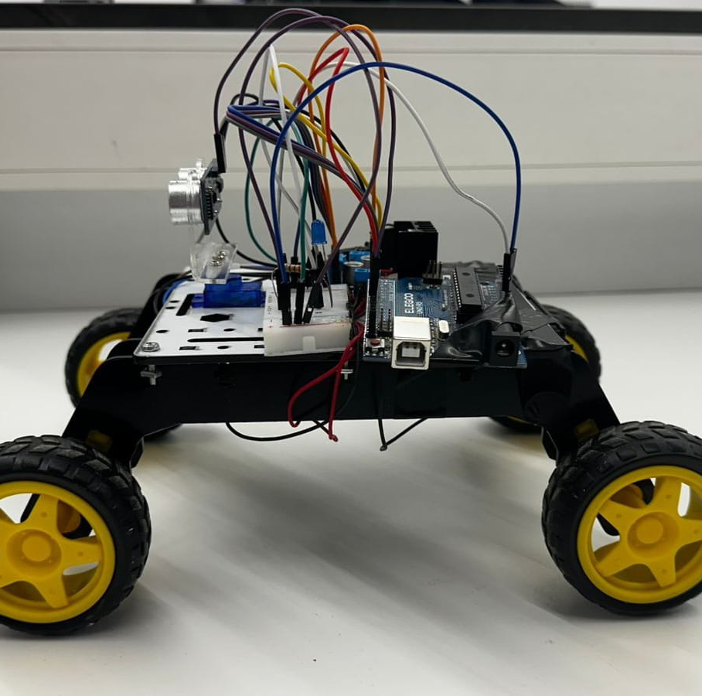
Thank you
Roba Hassan Rubaahassan@hotmail.com
Fares Almashharawi fares.fa777@gmail.com

